Slide 1



www.jobsplus.ie
JobsPlus

Slide 2
What is JobsPlus?
JobsPlus is an incentive to encourage employers and businesses to focus their recruitment efforts on those who are unemployed.

Slide 3
JobsPlus
&
the Employer

Slide 4
JobsPlus and the Employer
How much is it?
Is the grant taxed?
How often will an
employer get paid?
The grant rates are €7,500/€10,000 paid over 2 years. The amount the employer receives will depend on the age of the employee and their period of unemployment.
The grant is treated as income tax free for the employer only
N.B. An employer must pay the normal
tax rates for the JobsPlus employment.
The employer is paid monthly in arrears (€312.50/€416.67) over 24 months.
As long as the JobsPlus employee
remains in employment

Slide 5
Employer Eligibility
Who can apply?
What does the employer need to do?
Limits?
The JobsPlus incentive is open to employers in the private, community, not-for-profit and voluntary sectors.
The employer must be registered with the Revenue Commissioners as a PAYE Employer, and be tax compliant with a valid tax clearance certificate.
There are no limits to the number of eligible employees any one employer may hire under the incentive. Note: an employer may receive JobsPlus once only, in respect of the same employee

Slide 6
Employer - Vacancy Eligibility
The position must be considered a full time job of at least 30 hours per week, over 4 days per week to eligible recruits - (The employee must be on payroll and subject to PAYE and Class A PRSI).
The incentive is available when filling new positions or vacancies that arise as a result of natural turnover, For example retirements.
The Job/Vacancy:
New Positions:

Slide 7
The incentive cannot be used to support existing full time employees.
Yes, the vacancy/position cannot be supported under the JobsPlus scheme if the employer is receiving funding, or proposes to receive funding from other state sources for the vacancy.
Employer - Vacancy Eligibility contd.
Existing Employees:
Is there anything which could prevent an employer from receiving JobsPlus for a vacancy/position?

Slide 8
Register for JobsPlus:
What happens next?
Advertise the vacancy:
Employer Application Process:
Register online at www.jobsplus.ie
If an employer has already registered for JobsPlus they do not need to register again unless they are restructuring the company.
The employer’s application is processed by the JobsPlus team. They will email the employer to tell them of the approval/rejection.
They can advertise the vacancy free on www.jobsireland.ie OR
By contacting the local Intreo Centre/ Intreo Partners
Notes:
*The JP1 form is sent to the Employee if they are eligible for Jobsplus – Employee must complete Part ‘A’ and Employer must complete Part ‘B’
Jobpath Officers can inform JobsPlus approved Jobseekers about the employers vacancy. *** Do Not give the employer name of the individuals”””

Slide 9
Employer recruits a Jobsplus approved employee
What happens then?
Return the JP1 form to:
The JobsPlus approved employee provides the Employer with the *JP1 form:
- Part ‘A’ is completed by the employee and
- Part ‘B’ of the form must be completed by the Employer.
JobsPlus Unit,
Shannon Lodge,
Carrick on Shannon,
Co Leitrim, N41 KD81
Notes:
*The JP1 form is sent to the Employee if they are eligible for Jobsplus – Employee must complete Part ‘A’ and Employer must complete Part ‘B’
See Slides 15 ,16 and 17 for further information on the JP1 Journey.

Slide 10
JobsPlus and WPEP
A jobseekers time on the Work Placement Experience Programme (WPEP) counts towards JobsPlus eligibility.
An employer may be eligible to receive the JobsPlus grant when WPEP finishes.
Both employer and employee should apply online at www.jobsplus.ie

Slide 11
JobsPlus
&
the Jobseeker

Slide 12
Jobseeker Eligibility
Who is eligible:
How is the grant eligiblity assessed?
Jobseekers in receipt of Jobseekers payments/signing for PRSI jobseeker credits*, Disability Allowance or Blind Pension.
      * Credits are counted the same as if they were on JA/JB.
The length of time a jobseeker receives the qualifying payment will determine eligibility and the level of grant payment.

Slide 13
Jobseeker Eligibility (cont’d)
The Jobseeker must be on a qualifying payment:
Jobseeker Age/Category | Grant Amount | Period of Unemployment to qualify for applicable grant
Refugee Status or Jobseekers Transitional Payment | €7,500 | No qualifying period - automatically eligible
Under 30 | €7,500 €10,000 | Grant payable if unemployed 4 months (104 days) in the past 6 months Grant payable if unemployed 3 years (936 days) in the past 3.5 years
Over 30 and Under 50 | €7,500 €10,000 | Grant payable if unemployed 12 months (312 days) in the past 18 months Grant payable if unemployed 3 years (936 days) in the past 3.5 years
Over 50 | €10,000 | Grant payable if unemployed 12 months (312 days) in the past 18 months
A Jobseeker in the special category: Roma/Traveller OR History of Addiction OR Criminal Record | €10,000 | Grant payable if unemployed 4 months (104 days) in the past 6 months
For participants under 30 years, JobsPlus is co-funded by the Government of Ireland and the European Union

Slide 14
Jobseeker Eligibility – Anything Else?
Time in receipt of the PUP, on WPEP, training or other education schemes count towards eligibility.
To note, the following activities will require a qualifying payment before and after the activity:
    BTEA/BTWEA
    Maternity Benefit
    Short term Enterprise Allowance

Slide 15
Jobseeker Eligibility – Anything Else?
Jobseekers can go straight into a JobsPlus supported employment if they took part in any of the activities below and were in receipt of a qualifying payment prior to that activity:
    CE
    Tús
    RSS
    In Custody/Prison
    Solas/ETB – short duration courses
    Springboard Courses
    WPEP

Slide 16
Jobseeker Eligibility – Anything Else?
From January 2023, a jobseeker may be eligible for the higher rate of grant (€10,000) due to being a Traveller or person of Roma ethnicity, or due to having a recent criminal record or recent history of addiction.
If a jobseeker wishes to be assessed for JobsPlus on the above special categories, they must notify* the JobsPlus team by emailing:
              jobsplusinfo@welfare.ie
      *Note: This is a confidential process, and no details will be shared with third parties

Slide 17
JobsPlus
&
the Employment

Slide 18
JobsPlus and the Employment
What happens Next?
The JobsPlus team will issue the JobsPlus approval or non-approval letter directly to the jobseeker. The approval letter will contain a JP1 employment form.
    Part A to be completed by the Jobseeker
    Part B to be completed by the employer.
The completed JP1 form must be returned to the JobsPlus Unit in Carrick on Shannon as soon as possible in order to create the employment and set up the monthly payments.
The Jobseekers must be signed off the live register before the JobsPlus claim goes into
payment

Slide 19
Jobsplus and the Employment continued..
The JobsPlus Team assess the completed JP1:
    If everything is in order and the employment complies with the conditions of the scheme, the JobsPlus claim will go into payment.
    If the JobsPlus team need further information or clarification on any details on the returned JP1 form, the Employer will be contacted by email before the employment is awarded.
When the employment is awarded, the employer will be notified by email from the JobsPlus team.

Slide 20
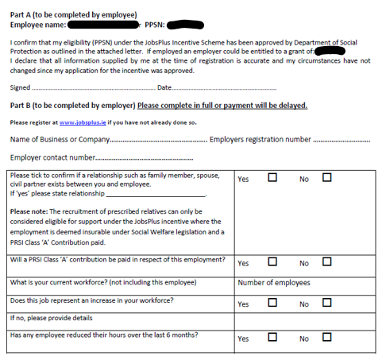
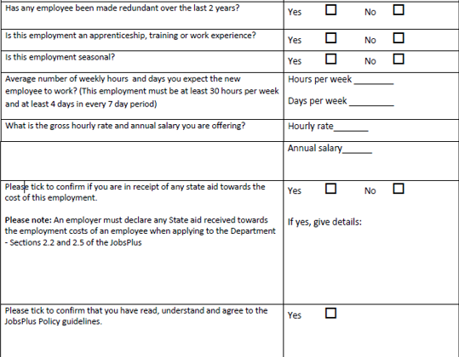
JobsPlus and the Employment – JP1 (example)

Slide 21
JobsPlus Priority Inbox
If you have a jobseeker attending an interview or has got a job and they have applied for a JobsPlus eligibility check – to fast track it please contact:
JobsPlusPriority@welfare.ie

Slide 22
JobsPlus Team Contact
If you have any queries about the JobsPlus scheme – please contact:
JobsPlusInfo@welfare.ie

Slide 23

JobsPlus
Register
www.jobsplus.ie

Slide 24
Questions?
Notes:
New information and tools to assist you with p

